Slide 1
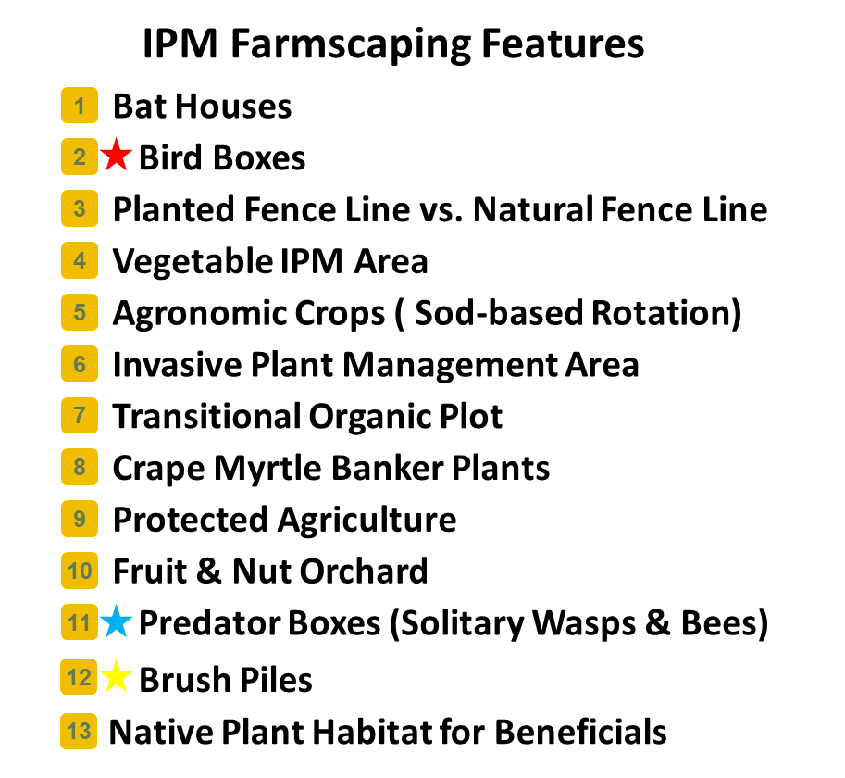
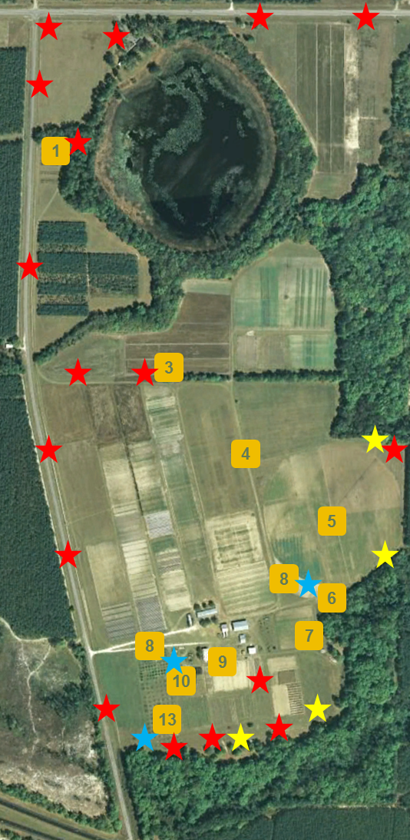
IPM in Suwannee County: Impacts of a Field Laboratory
S. Janine Parker & Glenn Israel – University of Florida
PURPOSE
Evaluate the Suwanee Valley Integrated Pest Management (IPM) Living Lab’s impact on its participants’ adoption of IPM practices and their perceptions of the Living Lab programming and workshops.
RESULTS
Programming
Generally liked the programming & workshops
Presenters were engaging
Materials were very helpful
Really enjoyed the hands-on activities
“They have this trolley, this open-air trolley, they pull with, I don’t know, a tractor or something. You actually went out to the field, and they gave you nets, bottles, and magnifying glasses. It was very hands-on.” – Respondent #5
“All of their classes involved good handouts, good audio-visuals, and hands-on.” – Respondent #6
Usage
All respondents used at least some of the information they received
“These are mammoth sunflowers, and they had them there at the Suwannee facility. They attract stink bugs, and I had one that had over a hundred of them on it. It was one about 12-14 inches across with brown leaf-footed stink bugs.” – Respondent #1
METHODS
Semi-structured interviews were used to capture a holistic view of farmers' IPM practices after their visits to the IPM field laboratory. Seven interviews were conducted on five farms with eight participants.
“We would probably have more [techniques] if I wasn’t so lazy. We have bat houses at the back of the woods and blue bird houses around.” – Respondent #6
Barriers
Time
Cost of inputs
“I don’t have a fully automated system. Do you know how much they want for those injectors and all that stuff? They want $2[00]-300 for an injector, plus a tank. It’s expensive.” – Respondent #1
“We run this farm all day every day, but there are a few things we would like to do that we haven’t had the time to do.” – Respondent #5
CONCLUSIONS
The goal of the Suwannee Valley IPM Living Lab is to create a whole farm-level IPM demonstration laboratory to deliver hands-on IPM training beyond the classroom. Based off of the respondents interviewed, the IPM Living Lab is meeting its goal. The Living Lab has engaging workshops and programs that provide hands-on experiences. Because of these types of programming, many of the respondents have implemented at least one of the techniques learned. Despite the few barriers indicated, like time and costs of inputs, respondents indicated an optimistic attitude towards using IPM techniques in the future.

